Slide 1

WORKLY -Employee Management System
20104043 Lakshit Patil
20104102 Kritika Donde
20104126 Disha Panchal
Project Guide
Mrs. Rujata Chaudhari
Notes:
1

Slide 2
Contents
Introduction
Objectives
Scope
Literature Survey
Proposed System
Project Outcomes
Block Diagram
Use Case/DFD
Technology Stack
Suggestions in Review-1
Result and Discussion
Conclusion and Future Scope
References
Notes:
2

Slide 3
1. Introduction
Problem Identified :
Manual handling of employee information poses a number of challenges
A number of current systems lack employee self-service meaning employees are not able to access and manage their personal information directly without having to go through their HR departments or their managers
Solution Proposed :
An employee management system provides managers with insights into their workforce, and helps them to better plan and manage work hours to easily control labor costs and increase productivity
Notes:
3

Slide 4
2. Objectives
To provide managers with insights into their workforce.
To help them to manage work hours.
To easily control labor costs.
To increase productivity.
To develop a system that will satisfied the customer services.
Notes:
4

Slide 5
3. Scope
Can help in maintaining the employee’s records.
Can focus on each employee’s attendance.
Can check salary report at anytime.
Can provide better Employee-Manager Relationship.
Notes:
5

Slide 6
4. Literature Review
(Paper1) (Kellerman, 2007, Pg 17)Employees not only need guidance from their managers or leaders, but they also need to know that they will be there to help them when they need them or to help put things back on the right track. Leadership need not imply that a leader is, by nature, wise, and inspirational. Darker forces sometimes drive leaders as well as their followers. Bad leadership is as ubiquitous as it is insidious.
(Paper 2) (Lazenby, 2008, Pg. 22)Once the relationship between employees and management starts to deteriorate, this can then lead to motivational issues. Managers need to realize that every employee is different. Some employees prefer to work independently while others like the continued feedback and support from their leaders. As Lazenby (2008) notes, “a one-size-fits-all apprach to employee motivation doesn’t work. Challenges that motivate one person might actually discourage another. Some individuals seem to have a high need for praise and recognition, even when their work is mediocre; others don’t seem to care about those things”.
Notes:
6

Slide 7
5. Proposed System
Features and Functionality:
Efficiency And Better Accuracy
Employee Productivity
Time and Attendance Management
Absent Management record
Employee record
Notes:
7

Slide 8
6. Outcome of Project
Users can operate it from anywhere at anytime.
New Employees can register through admin portal.
Users can view his/her details.
Users can apply for leave.
Notes:
8

Slide 9
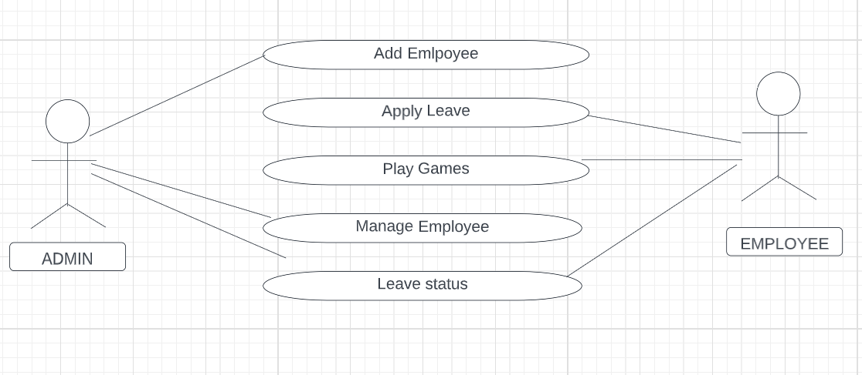
7. Use Case Diagram
Notes:
9

Slide 10



8. Technology Stack
Frontend :-Html(Hypertext Markup Language) , CSS, Bootstrap.
Backend :- MySql
IDE : Sublime
Notes:
10

Slide 11
9. Suggestions in Review-1
To add an option of timesheet and games.
To make changes in use case diagram.
To change homepage.
Notes:
11

Slide 12
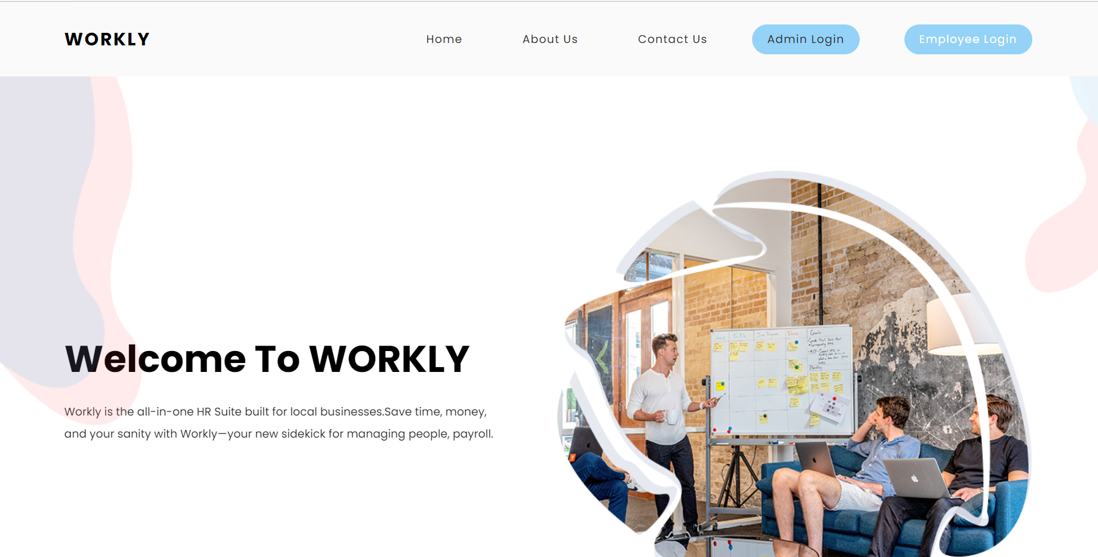
Home Page:
10. Result and Discussion

Slide 13
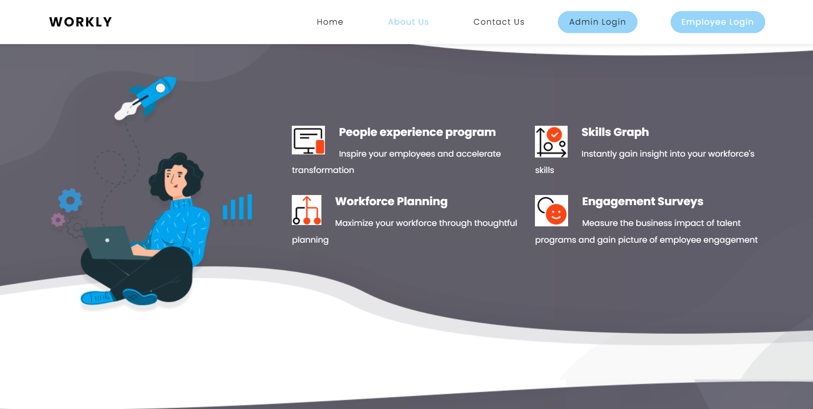
About Us Page:

Slide 14
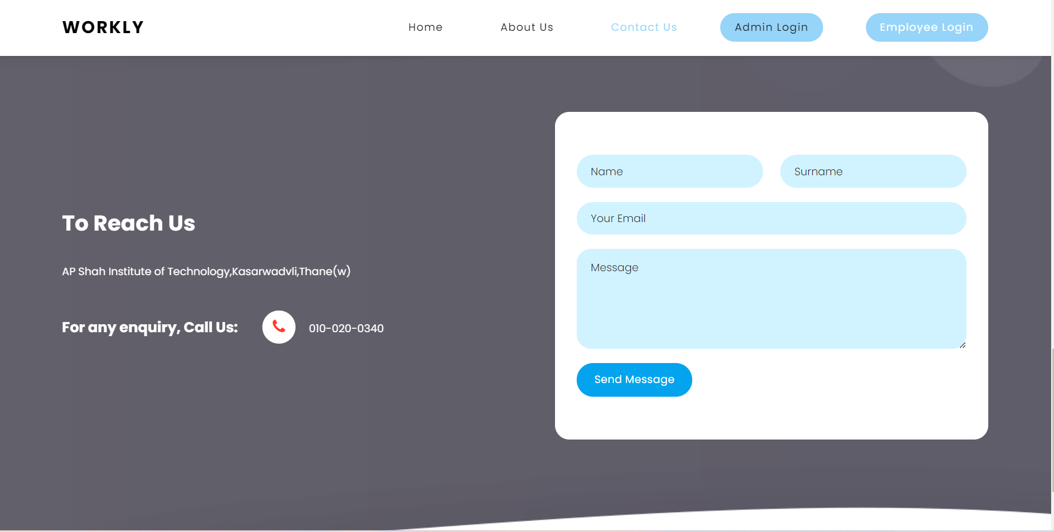
Contact Us Page:

Slide 15
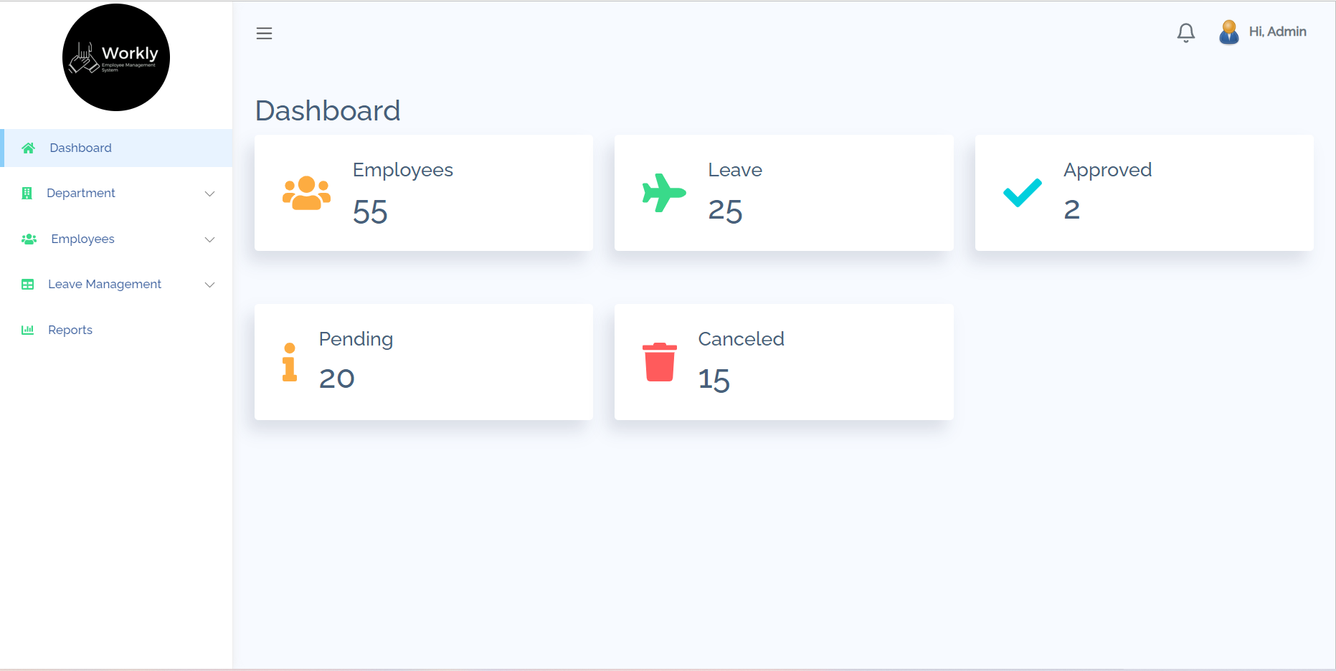
Admin Dashboard:

Slide 16
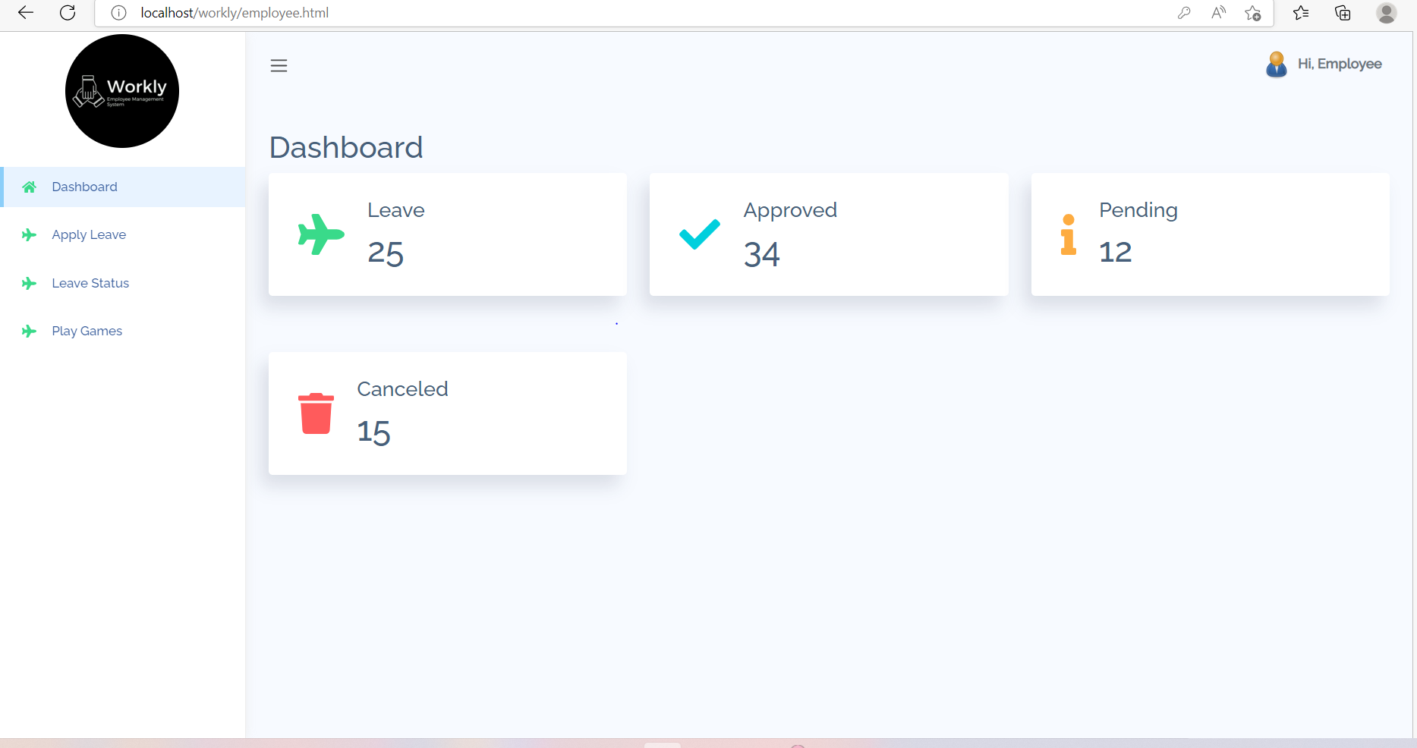
Employee Dashboard:

Slide 17
11.Conclusion and Future Scope
WORKLY helps your organization improve workforce productivity and boost overall well-being by tracking and monitoring the daily working activities of every employee.
Our project has very vast scope in future as it saves time of the employees.
It can also be updated in the future as and when requirement for the same arises.
Notes:
17

Slide 18
12. References
[1] ukessays.com/essays/management/review-of-literature-on-employee-management-management-essay.php
[2] https://www.freeprojectz.com/project-report/1657 [http://site.ebrary.com/lib/vaxjo/Doc?id=5002842 (2006-05-25).
[3] -https://itsourcecode.com/free-projects/php-project/human-resource-management-system-in-php-with-source-code/
Notes:
18

Slide 19
Thank You...!!
Notes:
19

